Slide 1
Name=Saunak Mukherjee batch=1840
Project name=customer Retention

Slide 2
Overview
In this customer retention project we will be looking on:
How to analyze the dataset of Customer Retention
What are the criterion to achieve Customer Retention
Overall analysis on the problem.

Slide 3
Customer Retention
Customer retention which is a metric that measures customer loyalty, or the ability for an organization to keep its customers over time. The addition to the identifying the number of loyal customers, customer retention can be reflect or predict customer satisfaction, repurchase behavior, customer engagement and emotionally ties to a brand.

Slide 4
Problem Statement
Customer satisfaction has emerged as one of the most important factors that guarantee the success of online store; it has been posited as a key stimulant of purchase, repurchase intentions and customer loyalty. A comprehensive review of the literature, theories and models have been carried out to propose the models for customer activation and customer retention. Five major factors that contributed to the success of an e-commerce store have been identified as: service quality, system quality, information quality, trust and net benefit. The research furthermore investigated the factors that influence the online customers repeat purchase intention. The combination of both utilitarian value and hedonistic values are needed to affect the repeat purchase intention (loyalty) positively.

Slide 5
EDA
I have imported the dataset which was in excel format. Then I did all the statistical analysis like checking shape, unique, value counts.
Then while looking into the value counts I found some duplicate entries in the features i.e., two words with same meaning. I have replaced those duplicates by grouping them.
I have checked for null values but there was no null values in the dataset.

Slide 6
Data Cleaning
The column names are very descriptive and they look hard to handle with unnecessary spacing so I have changed my column names which will be helpful for further studies.

Slide 7
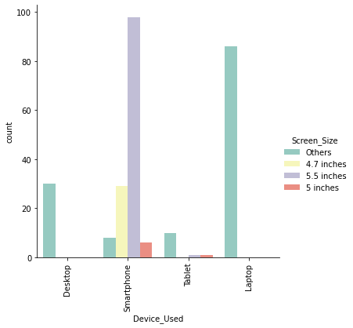
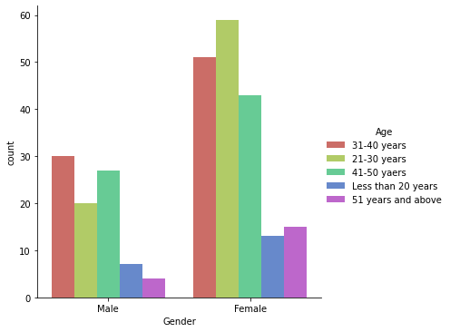
Vizualization:

Slide 8
Vizualization:
Female are doing more shopping compared to men and females with age group 21-30 and men of age group 31-40 are shopping more than other age groups.
I found more customers in Great Noida and they belong to above 4 years of online shopping experience.
In all the frequencies of online purchase in past 1 year the usage of mobile internet for internet access is having high count.
All the smartphone users has maximum count for 5.5 inches screen size and for all other devices screen size is not specified i.e., others option.

Slide 9
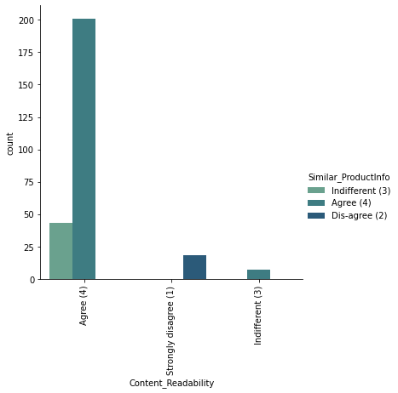
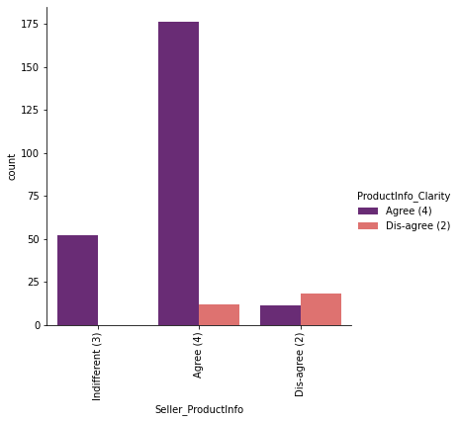
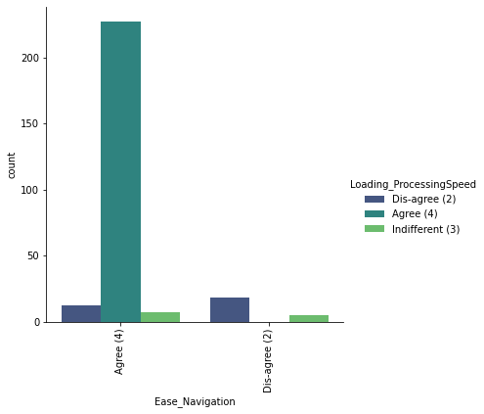
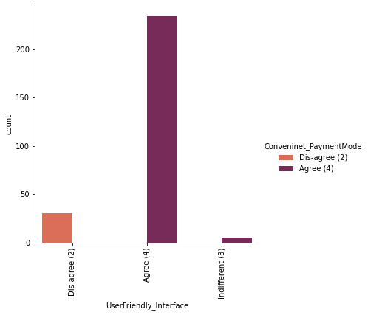
Vizualization:

Slide 10
Vizualization:
The maximum customers agrees to have the content on the web page to be easy to read and understand and also they agrees to get information on similar product to the one highlighted is important for product comparison.
Maximum people agrees to have all relevant information on listed products and agrees with complete information on listed seller and product being offered is important for purchase decision.
Maximum customers agrees to get easy navigation in website and they wants to have loading and processing speed.
Maximum customers wants user friendly interface of the website and convenient payment methods.

Slide 11
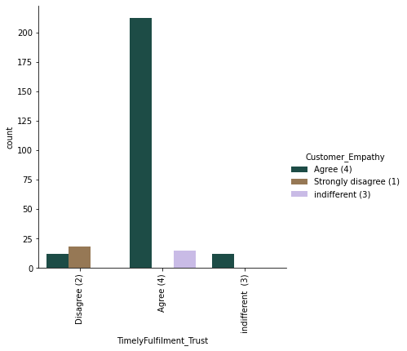
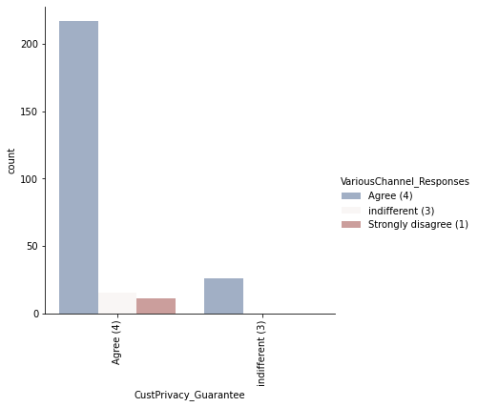
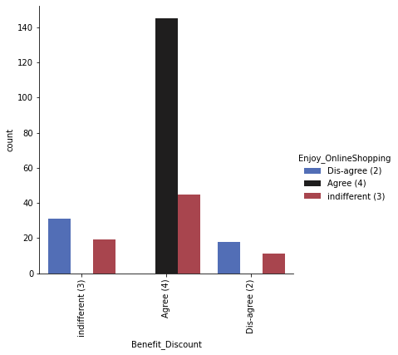
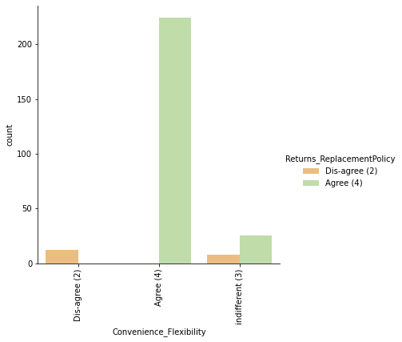
Vizualization:

Slide 12
Vizualization:
Maximum customers agrees to get Trust that the online retail store will fulfill its part of the transaction at the stipulated time and expects Empathy towards the customers.
Maximum customers wants to have the guarantee privacy of the customer and they wish to have Responsiveness, availability of several communication channels.
Maximum customers agrees that Online shopping gives monetary benefit and discounts and they also agrees that Enjoyment is derived from shopping online.
Maximum customers agrees that shopping online is convenient and flexible and they also agrees that return and replacement policy of the e-tailer is important for purchase decision.

Slide 13
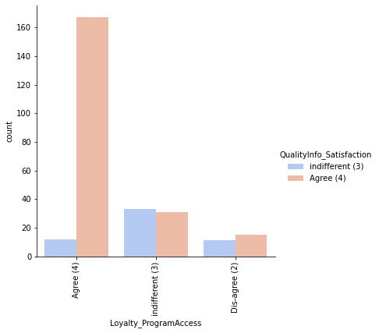
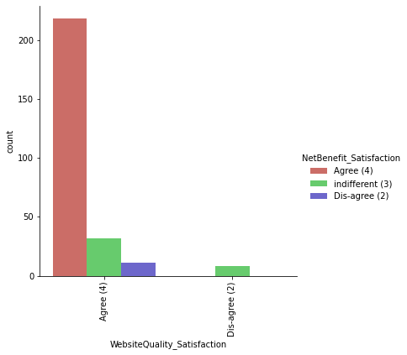
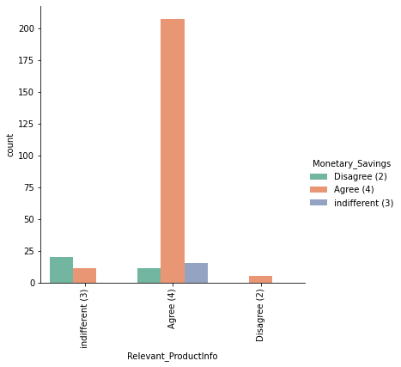
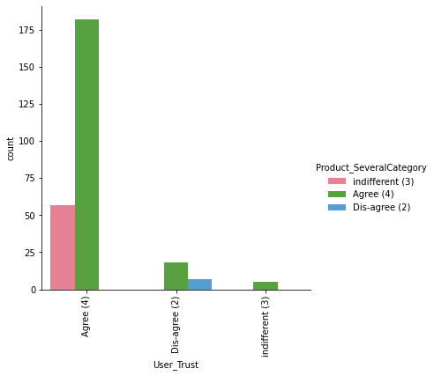
Vizualization:

Slide 14
Vizualization:
Max customers agrees with Gaining access to loyalty programs is a benefit of shopping online and they also agrees that displaying quality information on the website improves satisfaction of customers.
Maximum customers agrees that user derive satisfaction while shopping on a good quality website or application and they also agrees that net benefit derived from shopping online can lead to users satisfaction.
Max customers agrees to have user satisfaction cannot exist without trust and they also agrees that offering a wide variety of listed product in several category.
Max customers agrees to have provision of complete and relevant product information and they also agrees to have monetary savings.

Slide 15
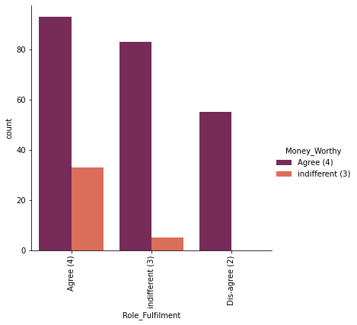
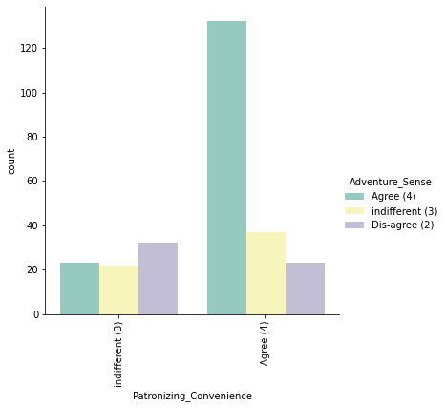
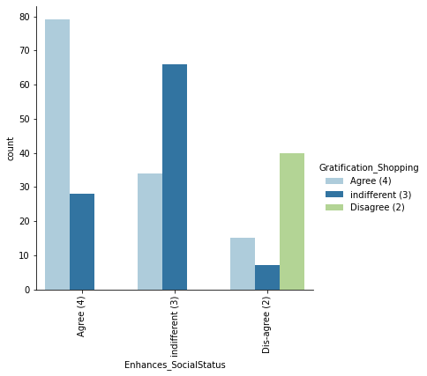
Vizualization:

Slide 16
Vizualization:
Max customers agrees for having the convenience of patronizing the online retailer and they also agrees that shopping on website gives us the sense of adventure.
Max customers agrees that we feel gratification shopping on there favorite e-tailer and they also agrees that shopping on your preferred e-tailer enhances there social status.
Max customers agrees shopping on the websites helps to fulfill certain roles and they also agrees that getting value for money spent.

Slide 17
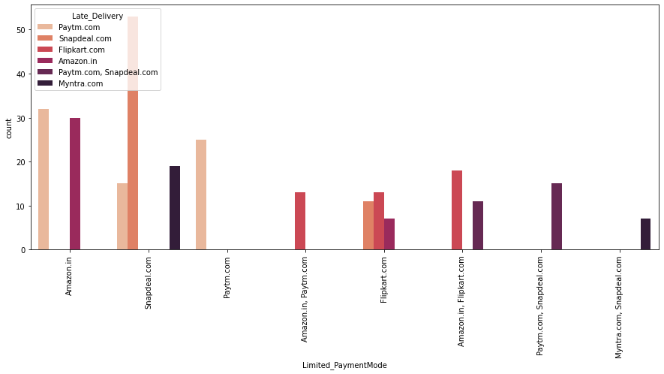
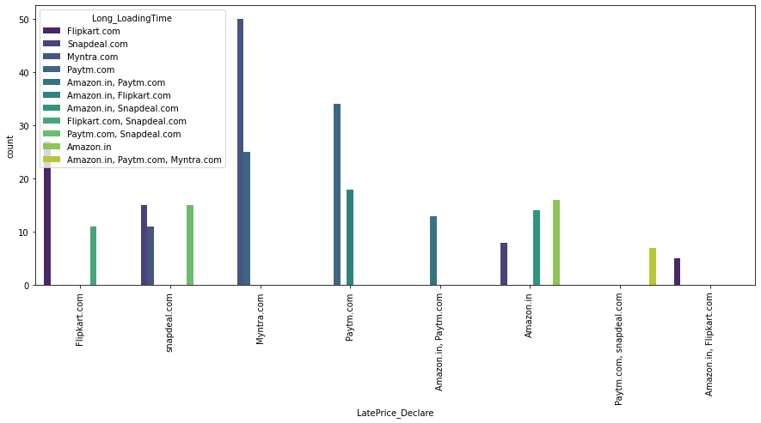
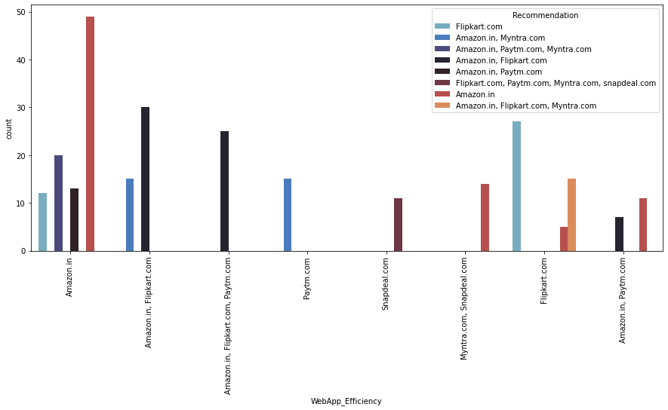
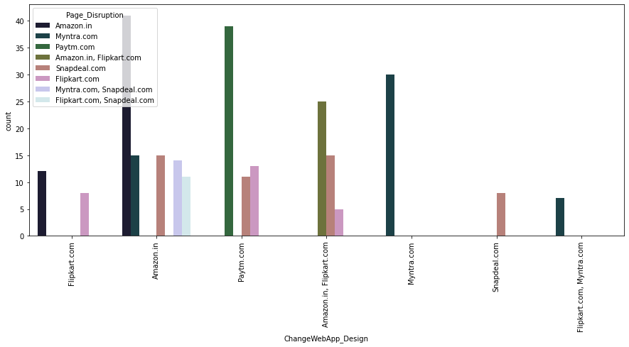
Vizualization:

Slide 18
Vizualization:
Max customers says that the drawback of having late declaration of price is with Myntra and longer page loading time is with Flipkart.
Snapdeal has a drawback of having limited payment modes and also it has a complaint of late delivery.
Max customers says that Amazon is the platform with good wedsite/application design and also amazon has a drawback of disruption of pages when moving from one page to another.
Max customers says that the efficiency of website is good with Amazon and also amazon is recommended by most of the customers.

Slide 19
Analysis
We have seen that most of the customers are females with age from 20-50 and they used mobile internet to access with Windows as operating system.
And most of the customers used search engines to get into the platform first time and frequently.
Max customers uses there debit/credit cards for there payment.
Almost customers has a expectation to have Content_Readability, Similar_ProductInfo, Seller_ProductInfo, ProductInfo_Clarity, Ease_Navigation, Loading_ProcessingSpeed, UserFriendly_Interface, Conveninet_PaymentMode, TimelyFulfilment_Trust, Customer_Empathy, CustPrivacy_Guarantee, VariousChannel_Responses, Benefit_Discount, Enjoy_OnlineShopping, Convenience_Flexibility, Returns_ReplacementPolicy, Loyalty_ProgramAccess, QualityInfo_Satisfaction, WebsiteQuality_Satisfaction, NetBenefit_Satisfaction, User_Trust, Product_SeveralCategory, Relevant_ProductInfo, Monetary_Savings, Patronizing_Convenience, Adventure_Sense, Enhances_SocialStatus, Gratification_Shopping, Role_Fulfilment, Money_Worthy in e-commerce websites.

Slide 20
Conclusion
Organisation will be always focus on success for that keeping the old customers will always be a plus point.
Also Paytm and Snapdeal which has maximum drawbacks it is because of their dead old strategies.
I found Amazon and Flipkart are standing best out in the market by using ethical, reasonable business strategies.
To conclude, having the right customer retention strategy will keep sellers company growing if they know how to take advantage of it. Then customers will find their way back and continue buying stuff from the best company.

Slide 21
Thank You

